Slide 1

Trojan Malware
CS 373 Defense Against the Dark Arts
Cas Donoghue
Notes:
Must be in Slide Master mode to swap out photos.

Slide 2
Overview
What is Trojan malware?
What are the parts of a Trojan?
Demo program
Deep dive into Shakti Trojan

Slide 3
Definitions
Malware: Malicious software
Virus: Infect multiple components on disk and tries to spread
Worm: Installs once and tries to get to another system
Trojan: Masquerade as something benign or useful for the user

Slide 4
Components
Legitimate program/file to hide in
Exploit mechanism
Payload
Obfuscation

Slide 5
Trojan Intent
Backdoor: remote control over infected device
Information stealing: Bank, document, other
Downloader/dropper: mechanism for installing other programs

Slide 6
Code Example
Illustrate a command and control trojan
Use python to write a Trojan program (dancing rabbit)
Also implement a server that can control the Trojan program
Used to illustrate command and control server
Github: https://github.com/donoghuc/CS_362_python_trojan

Slide 7
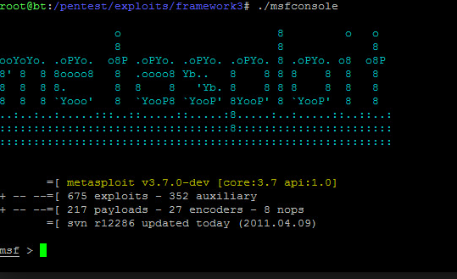
Improvements
Metasploit
System for injecting pre-canned or custom malware into existing applications while preserving intended behavior
Options for obfuscation and advanced cloaking techniques
Too scared…

Slide 8
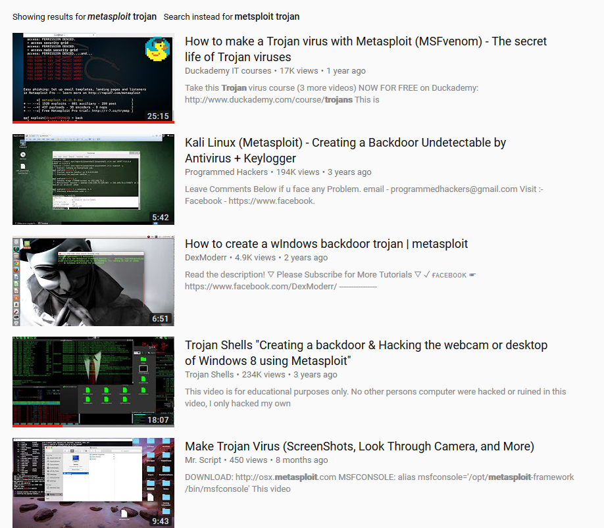

Slide 9

Shakti Trojan
Document stealing Trojan
Infects system, scans for document
Sends document to C&C server
Strings in source code and other attribution methods indicate program was called “Shakti”

Slide 10
High Level Overview
On execution configures a windows registry key for persistence
Runs silently and hides in browser processes
Communicates with C&C server over HTTP with MSMQ protocol headers (plain text)
First beacons to the C&C server with basic computer info
Once it gets a response it sends every file with following extensions:

Slide 11
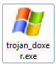
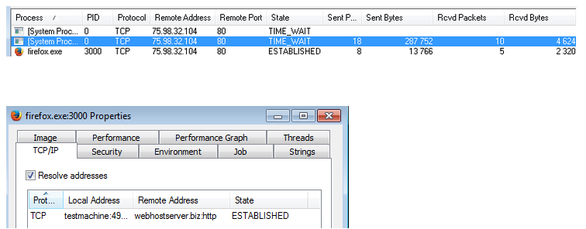
Initial infection
Packed in loader executable with windows icon
Tries to install itself as a service, if that fails add registry key.
Will inject into
browser process

Slide 12
C&C Server Communication
HTTP POST request (URL pattern: http://[ CnC address]/external/update)
Victim's computer name
User name
Version of Windows
Installed Service Pack
List of programs found under HKLM\Software\Microsoft\Windows\CurrentVersion\Uninstall registry key

Slide 13
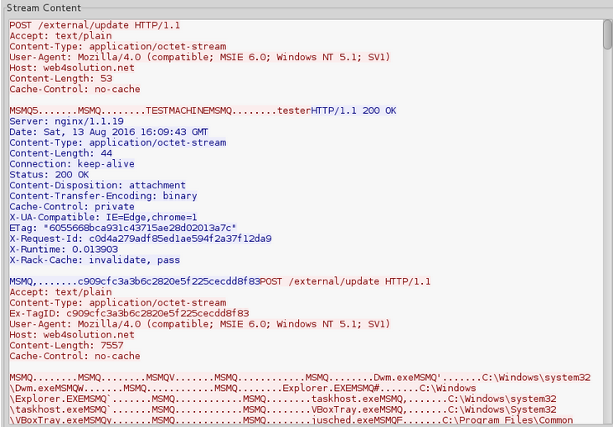
Initial Communication

Slide 14
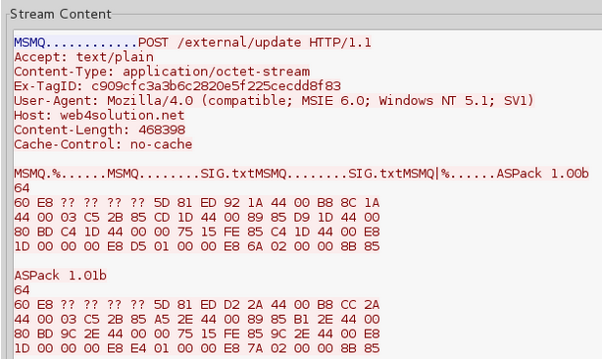
Secondary communication
Send all files with matching extension. First filename, then content.

Slide 15
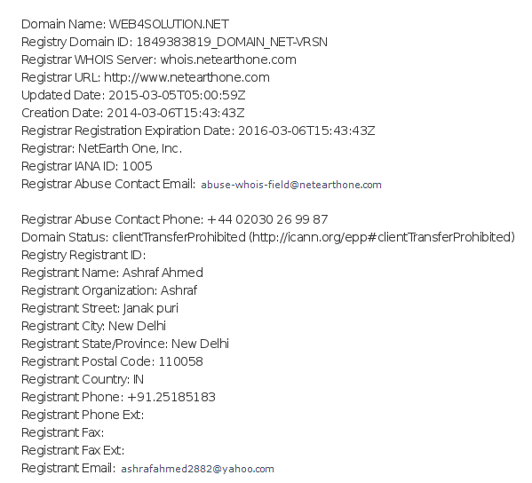
Attribution

Slide 16
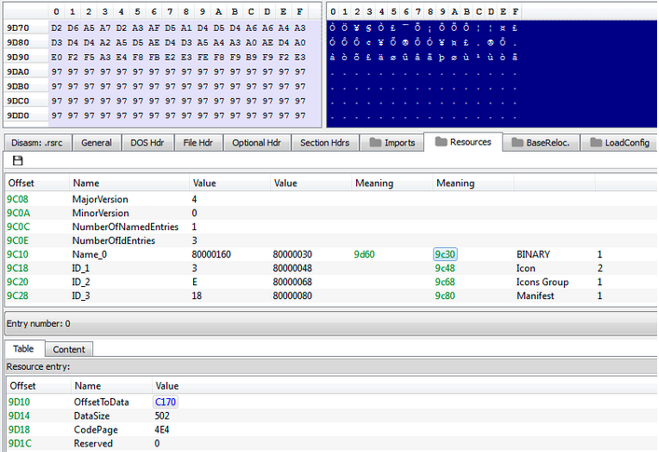
Technical Analysis
Main executable is obfuscated with XOR offset 0x97

Slide 17
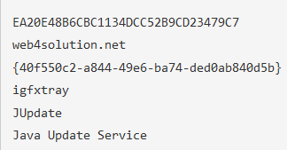
Obfuscation
Configuration contains following:
Flow obfuscation
Reflective Loader: map PE file into memory
Hidden PE files in overlay: Carrier.dll and Payload.dll

Slide 18
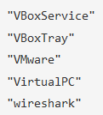
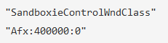
Carrier.dll
Check environment, install and run Payload
If configuration checks pass move on
Defensive techniques
Check for debugger
Looks for blacklist processes:
Checks for sandbox (SbieDll.dll)
Looks for blacklist window:

Slide 19
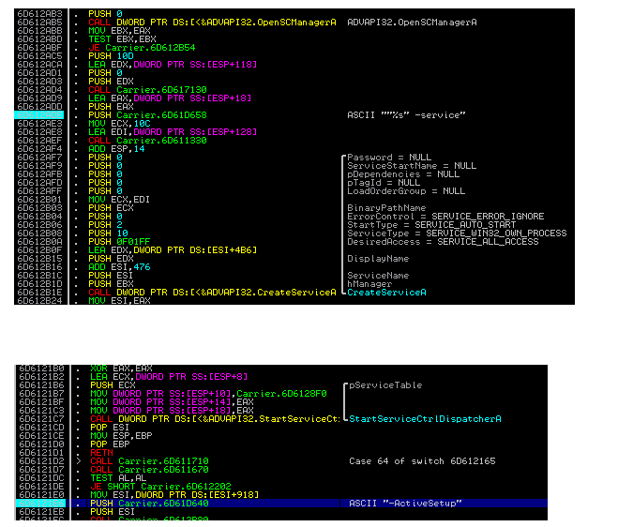
Carrier.dll
Checks permission, if admin installs as “Java Update Service” else registry key

Slide 20
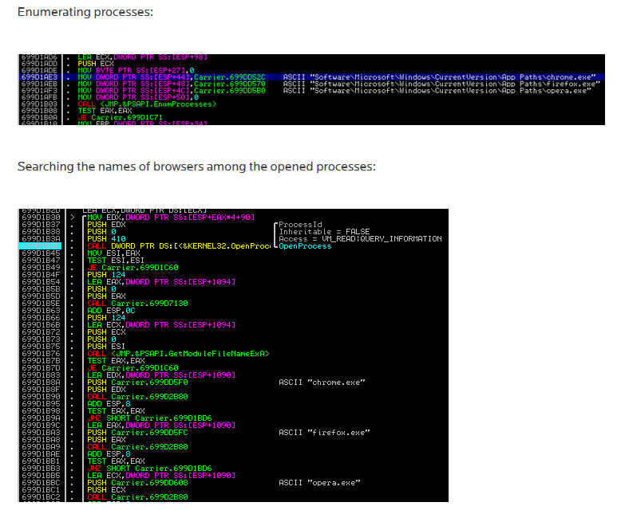

Slide 21
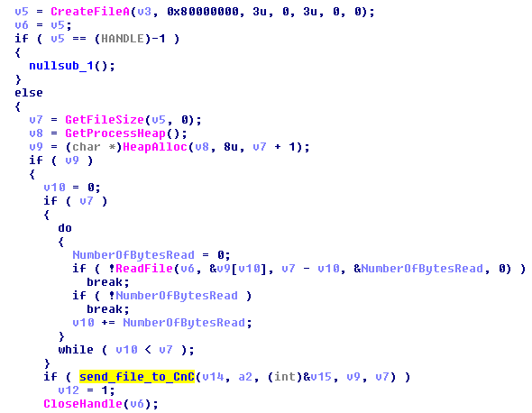
Payload.dll
File stealer
Searches all drives for extension:
List of files is sent to C&C server

Slide 22
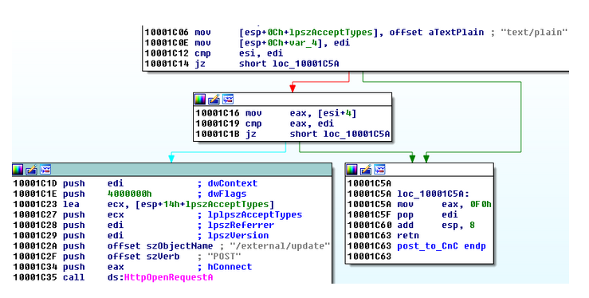
Payload.dll
User agent string hard coded as “Mozilla/4.0”
Server address from config file

Slide 23
Conclusion
Basic information about Trojans
Demo C&C server/target
Shakti analysis
Defense

Slide 24
References
Code Idea
https://github.com/alexAubin/evilBunnyTrojan
my Code
https://github.com/donoghuc/CS_362_python_trojan
Kaspersky Definition
https://usa.kaspersky.com/resource-center/threats/trojans
Shakti
https://blog.malwarebytes.com/threat-analysis/2016/08/shakti-trojan-technical-analysis/
https://blog.malwarebytes.com/threat-analysis/2016/08/shakti-trojan-stealing-documents/
https://www.bleepingcomputer.com/news/security/new-information-stealing-trojan-steals-and-uploads-corporate-files/
https://www.perspectiverisk.com/shakti-trojan/
https://www.virustotal.com/en/file/d6d64c61dada8b5ccfa970356057a6c2c7697f084922744c5a2e29aff079647b/analysis/
metasploit
https://null-byte.wonderhowto.com/how-to/hide-virus-inside-fake-picture-0168183/
Shakti image
https://en.wikipedia.org/wiki/Shakti#/media/File:Tripura_sundari_4.jpg
metsploit image
https://www.google.com/search?q=metasploit&client=firefox-b-1-ab&source=lnms&tbm=isch&sa=X&ved=0ahUKEwiH5pvP6_3ZAhUC1mMKHagLCK0Q_AUIDSgE&biw=1920&bih=983#imgrc=Q753pBnohrOqQM:

